Slide 1
LBT Innovations - AusBiotech 2021
Proven AI technology disrupting global microbiology market
Brent Barnes
CEO & Managing Director
26 October 2021

Slide 2
Disclaimer
This document contains certain forward-looking statements that involve risks and uncertainties. Although we believe that the expectations reflected in the forward-looking statements are reasonable at this time, we can give no assurance that these expectations will prove to be correct.
Given these uncertainties, readers are cautioned not to place undue reliance on any forward-looking statements. Actual results could differ materially from those anticipated in these forward-looking statements due to many important factors, risk and uncertainties including, without limitation, risks associated with estimating potential quantity and timing of sales, risks associated with medical device development and manufacture, risks inherent in the extensive regulatory approval processes mandated by regulatory authorities, delays in clinical trials, future capital needs, general economic uncertainly and other risks detailed from time to time in the Company’s announcements to the ASX.
Moreover, there can be no assurance that others will not independently develop similar products or processes or design around patents owned or licensed by the Company, or that patents owned or licensed by the Company will provide meaningful protection or competitive advantages.
All reasonable efforts have been made to provide accurate information, but the Company does not undertake any obligation to release publicly any revisions to any “forward-looking statement” to reflect events or circumstances after the date of this presentation, except as may be required under applicable laws. Recipients should make their own enquiries in relation to any investment decisions from a licensed investment advisor.
NOT AN OFFER FOR SECURITIES
This Presentation is not a prospectus, product disclosure statement or other offering document under Australian law (and will not be lodged with ASIC) or any other law. This Presentation does not constitute an offer, invitation, solicitation or recommendation with respect to the purchase or sale of any shares nor does it constitute financial product or investment advice nor take into account your investment objectives, taxation situation, financial situation or needs. An investor must not act on the basis of any matter contained in this Presentation but must make its own assessment of the Company and conduct its own investigations and analysis. Before making an investment in the Company, a prospective investor should consider whether such an investment is appropriate to their particular investment objectives and financial situation and seek appropriate advice, including legal, taxation and financial advice appropriate to their jurisdiction and circumstances.
UNITED STATES
The Company’s securities have not been and will not be registered under the U.S. Securities Act of 1933, as amended (the Securities Act), or under the securities laws of any state or other jurisdiction of the United States. Accordingly, the Company’s securities may not be offered or sold, directly or indirectly, within the United States or to, or for the account of benefit of, U.S. Persons (as defined in Regulation S under the Securities Act as amended). This Presentation may not be distributed within the United States or to any person in the United States
OTHER JURISDICTIONS
This Presentation may only be accessed in other jurisdictions where it is legal to do so.

Slide 3
Clinical microbiology: US$3.9bn global market¹
Current laboratory workflow remains highly manual – Ripe for disruption
Rising incidence of infectious diseases
>2.4bn culture plates read annually
Increasing demand on clinical resources
Workforce vacancy rates >10% in US²
Technology advancements
New products needed to meet demand
Exciting investment opportunity
Market growth at 6.5% per annum¹
1. Market Research Report, marketsandmarkets.com (Oct 2020): Clinical Microbiology Market by Application (Food, Pharma, Manufacturing, Chemical, Environment), Disease (Respiratory, Std, Uti), Product (Instrument, Analyzer, Reagent), End User (Hospital, Diagnostic Lab, Academia) - Global Forecast to 2025
2. MLO’s 2021 Annual Salary Survey of laboratory professionals; Feb. 22, 2021.
Notes:
Market Opportunity and Need Slide
Problem:
UTIs already cost Australia’s health system $909 million per year
Antimicrobial resistance (AMR) is one of the greatest threats facing humanity
The rise of superbugs, which claimed the lives of an estimated 700,000
Some estimates indicate that superbugs, also known as antimicrobial resistance (AMR), could cost the global economy US$100 trillion by 2050 including a 5-10 per cent reduction in Australia's GDP.

Slide 4
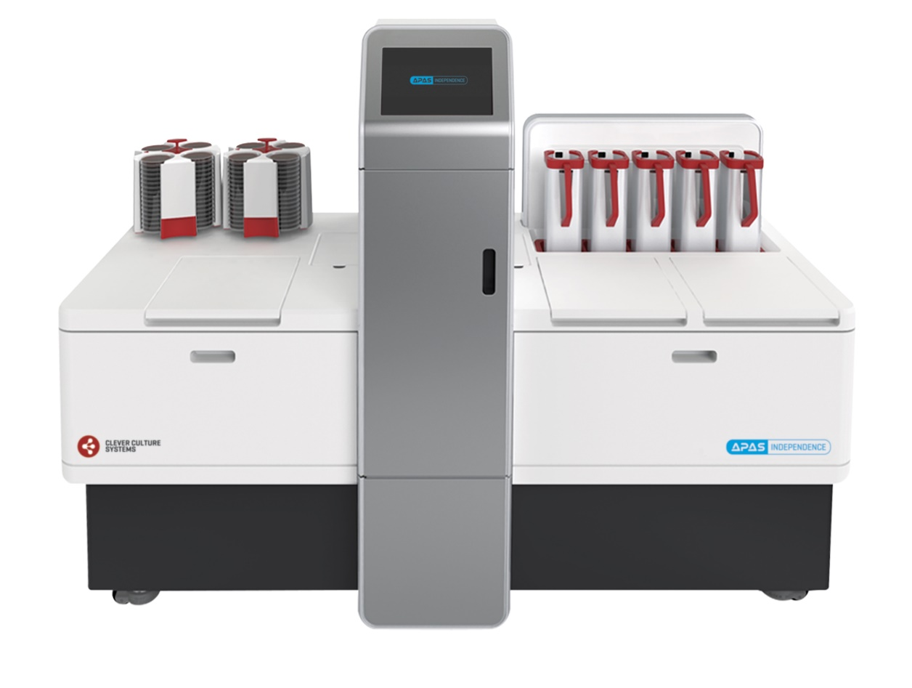
Leading the way in digital microbiology
APAS® Independence - First and only automated culture plate reader
Innovative platform technology
One instrument - multiple products
Clinically proven
Over 15 scientific publications
Global regulatory clearances
FDA, CE Mark, UKCA, TGA
Product launched - Global sales Australia, Germany, UK, US
Industry leading Channel Partners
EU: Beckman Coulter (Jul-20)
US: Thermo Fisher Scientific (Sep-21)

Slide 5
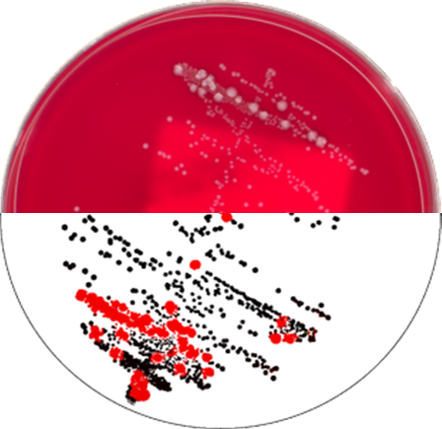
Cutting edge AI technology
Patent protected APAS® technology for culture plate reading
Microbiologist view
Manual reading
Automatic Plate Assessment System (APAS®)
3x Faster than a microbiologist
Able to process over 200 plates/hr
Accurate growth detection
Clinically validated performance
Efficient use of resources
60-90% plates automatically reported
APAS® Instrument
Automated AI interpretation

Slide 6
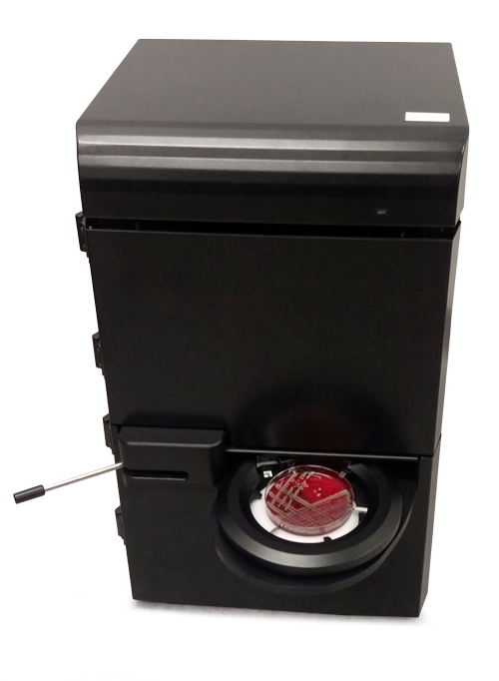
Commercialisation platform delivered
Clinically Proven – Regulatory Cleared – Channel partners in place
2016
2018
2019
2020-21
Technology validated
FDA Clearance for APAS® Compact device
Platform technology
High throughput device for culture plate reading
Global KOLs established
First Australian sale
Global product launch
FDA Clearance - US
CE Mark - EU
First overseas sale
Growing Adoption
Channel partners appointed
Beckman Coulter, Inc
Thermo Fisher Scientific, Inc
Early adopter sales - US, DE, UK
Notes:
Move BC to same slide
Move 2021 to this slide
- Simplify wording

Slide 7
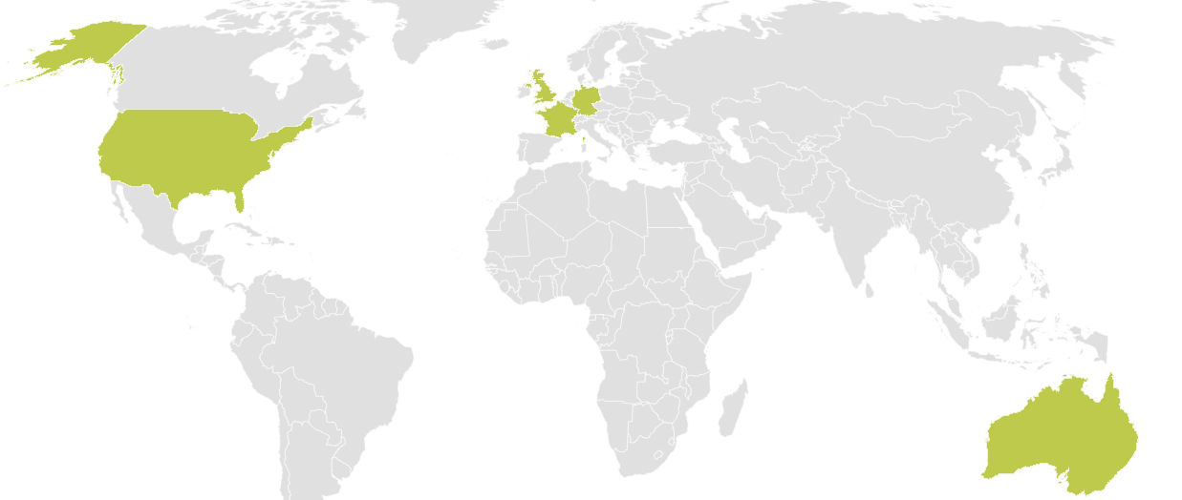
Global market opportunity
Addressable launch market: >2,000 laboratories or US$1bn
USA
>1,500 Labs or US$0.68bn in TAM
Thermo Fisher: Exclusive Distributor
Sales: Hennepin Health, MN
EU: UK, Germany and France
500 Labs or US$0.22bn
Beckman Coulter: Marketing Partner
Sales: Labor Dr Wisplinghoff, DE
Limbach Group, DE
HSL, Sonic Group (2), UK
Australia (HQ)
50 Labs or US$25m in TAM
Direct Sales
Sales: St Vincent’s Hospital
50:50 Joint Venture
Profits shared equally
APAS Independence Sales

Slide 8
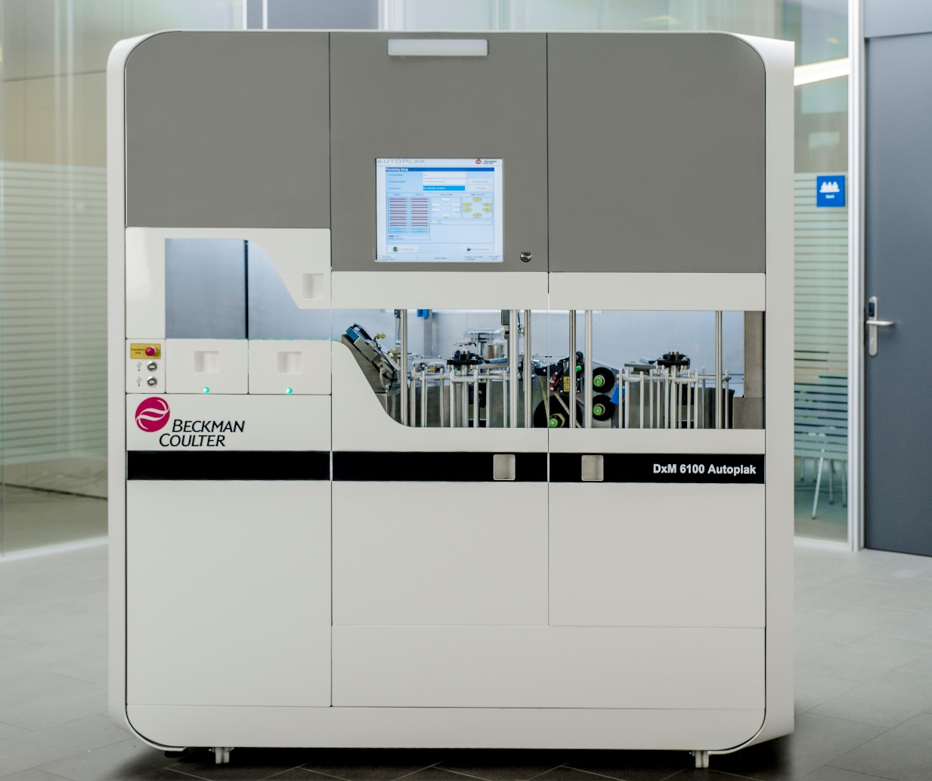
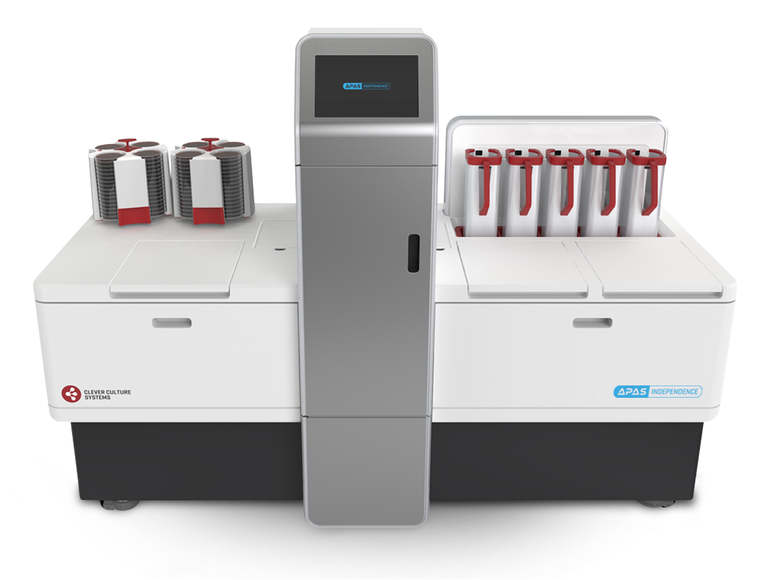
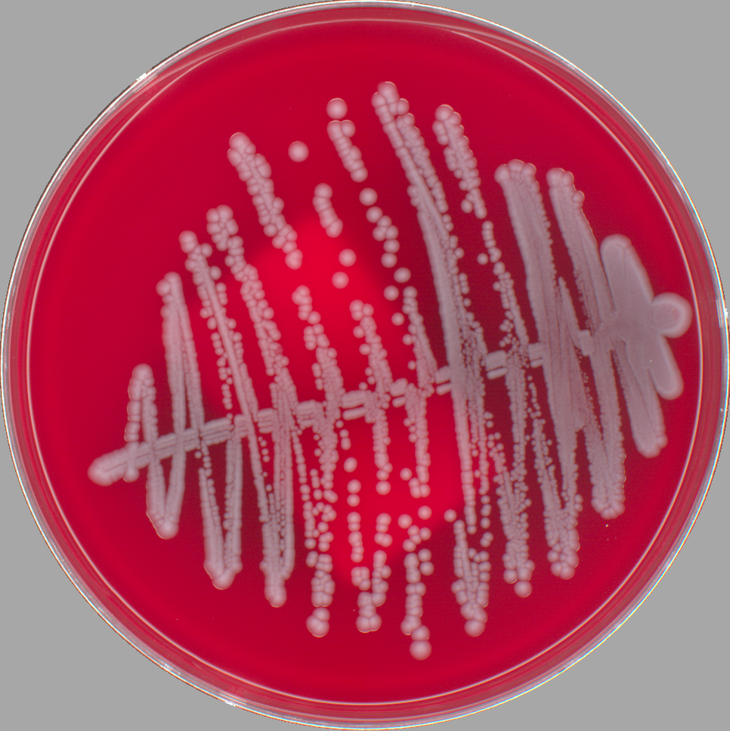
Commercial partnerships to scale - US and EU
Sales partnerships with global leaders for two largest markets
United States
Exclusive Distribution + Service & Support
North America Sales: ~US$20bn (2020)¹
Market leader in media for microbiology
Strategy to bundle APAS® and consumables
Europe (France, Germany, UK)
3-year Marketing Agent Agreement
Diagnostics Revenue: US$7.4bn (2020)¹
APAS® completes modular automation solution
APAS® Independence
Remel² Media
Beckman Coulter Workstation Automation
1. Figures from 2020 Annual Reports
2. Remel = Thermo Fisher US Media Brand

Slide 9
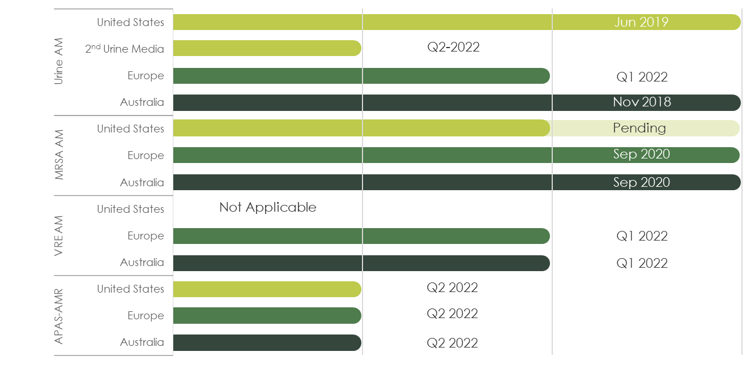
APAS® technology pipeline
Growing suite of analysis modules to increase customer value proposition
In Development
Evaluation Module
Regulatory Cleared
Notes:
2nd Urine Media

Slide 10
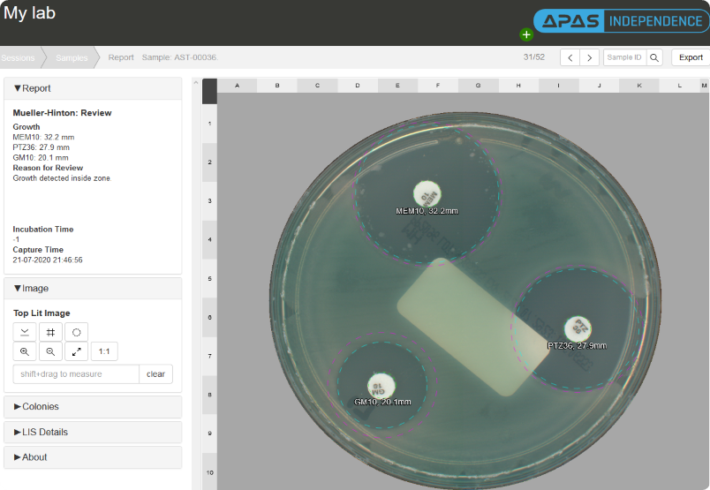
New technology developments
Antimicrobial resistance
Top 10 global health threat (WHO)
APAS®-AMR informs optimal antimicrobial treatment
In development. Supported by $0.75m BTB Funding (Sep-20)
APAS® Early plate reading
Ability to detects bacterial growth in <13hrs
Significantly reduces time to diagnosis - saving lives
Proof-of-Concept completed. Data presented at ECCMID (Jul-21)
New industry applications
Exciting opportunity - Pharmaceutical market
Feasibility underway. Clean room environmental monitoring
APAS®-AMR web report

Slide 11
Commercial outlook and goals
Technology and partners drive greater market adoption
2022
2025
Early adopter sales through channel partners
Market leader in intelligent microbiology automation
Technology: Expand clinical utility
Multiple AMs released for key markets
APAS®-AMR first customer use
Technology: Validated & expanded
Multiple APAS® products launched
Largest database of digital culture plates
Scientific Data: 6 Publications
Validated cost savings and laboratory ROI
Increased market opportunity
Expanded distribution coverage
New industry verticals added
Customers: Early adopters
Technology innovators and reference labs
Customers: Established user base
APAS® technology gold standard for culture plate reading
Growing sales, supported by strategic partnerships
Global sales and established ARR through licence fees
Notes:
Each 1% market penetration = $XXXm
=> Size of market
2021 leading to 2025
2022
Technology
Growing sales through partnerships
2 modules in key markets
APAS-AMR released for first customer use
Market Opportunity
Customers
Early adopters >> growing installed base

Slide 12
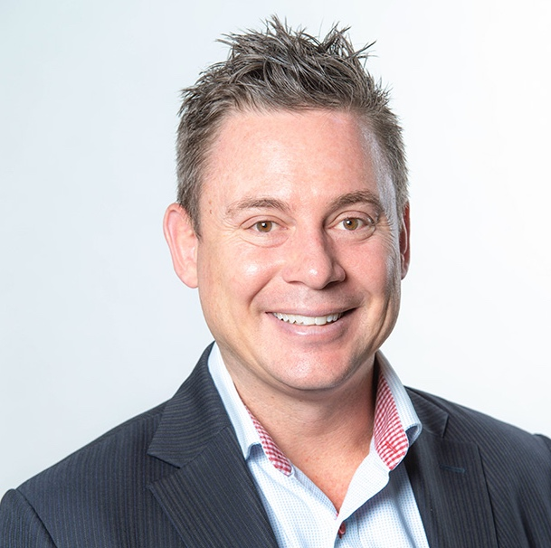
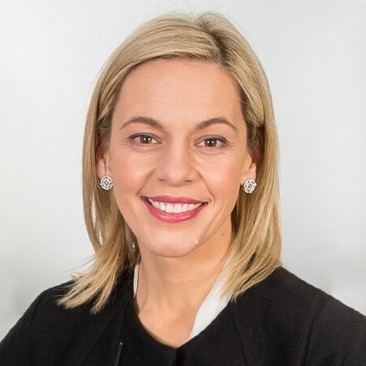
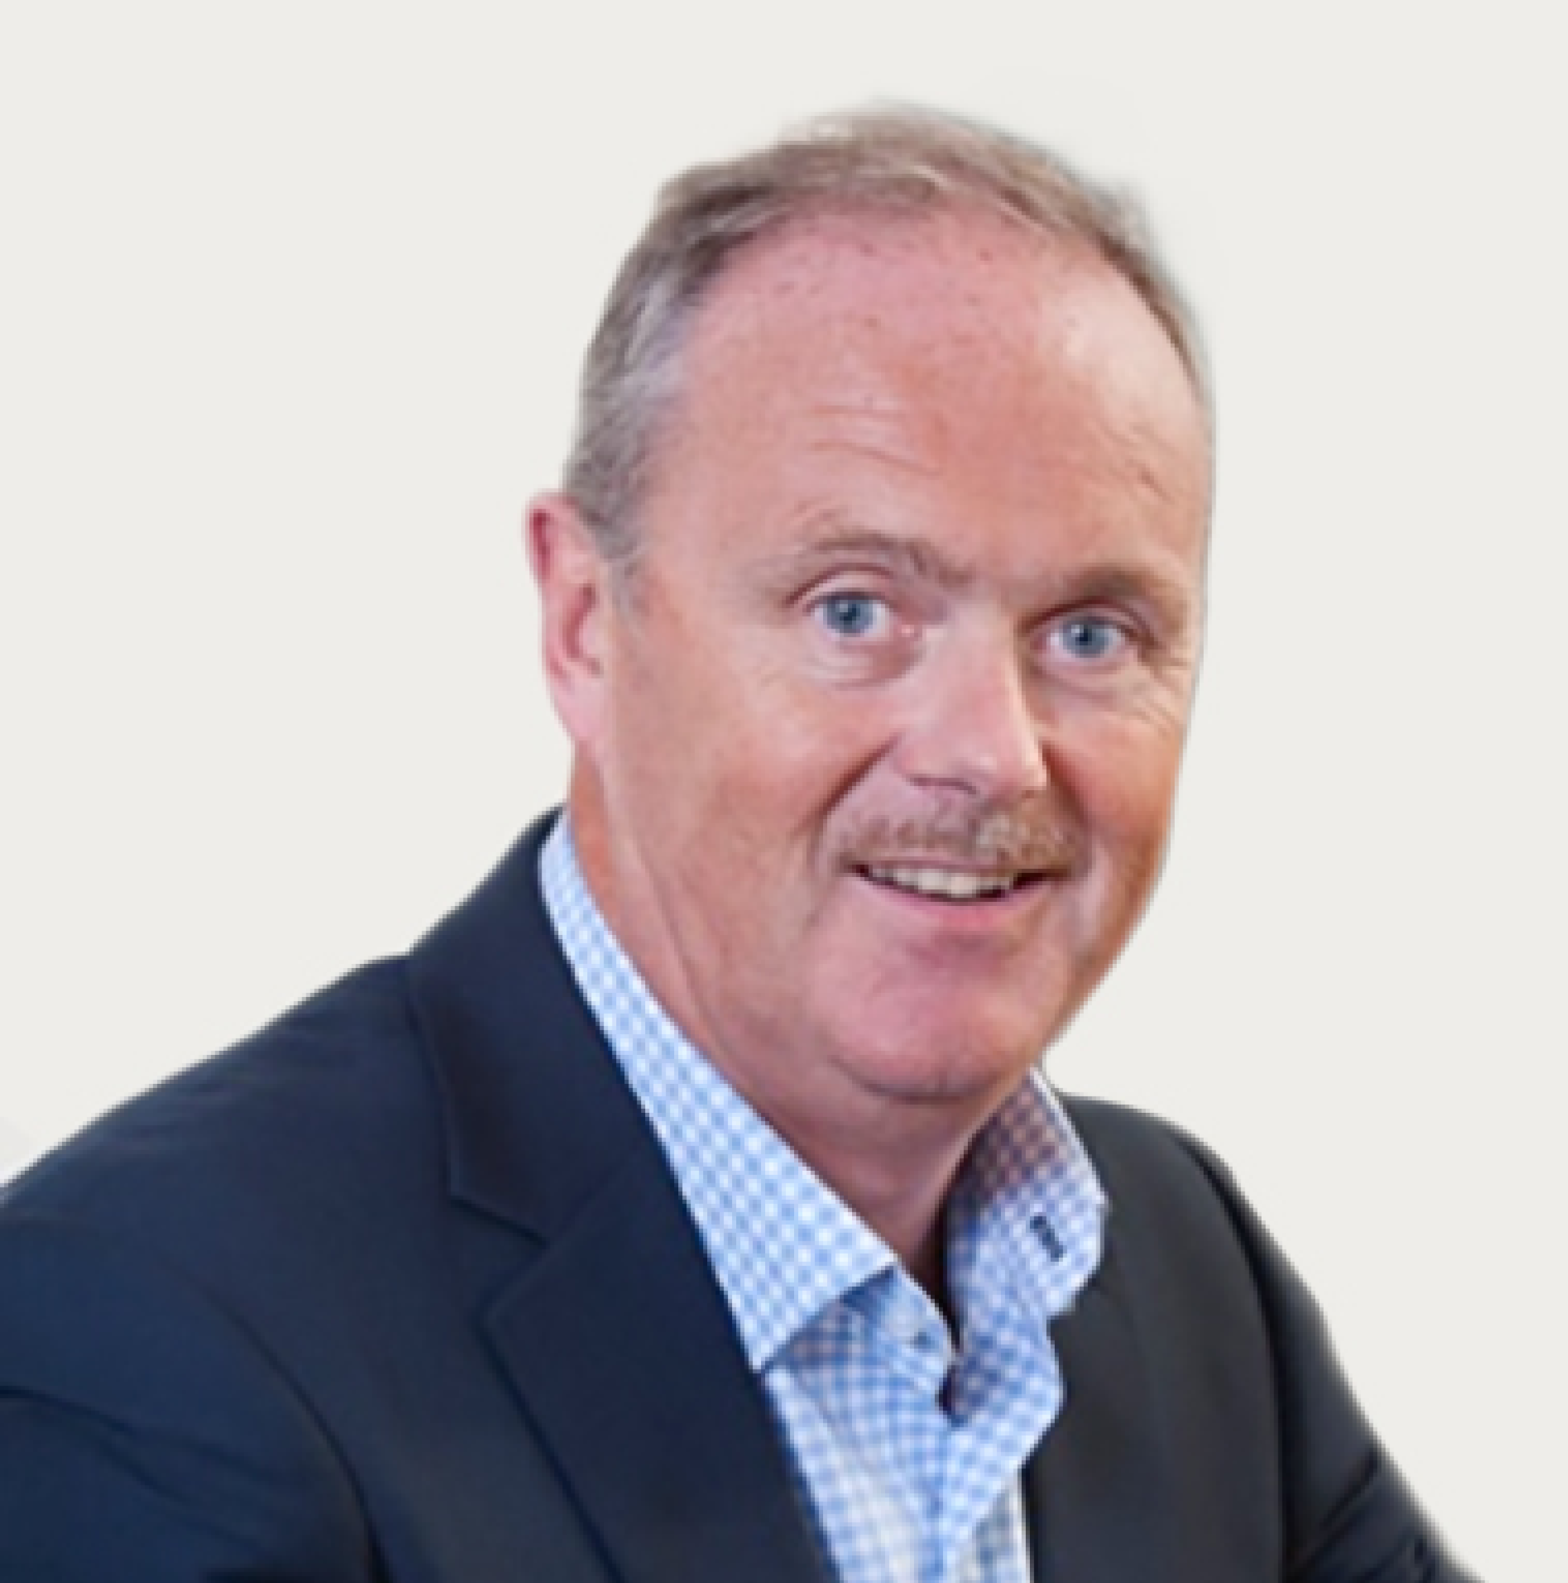
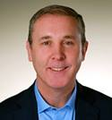
Experienced Board & leadership team
Refreshed Board with global commercialisation and technology expertise
Damian Lismore
NED, AU
Simon Arkell
NED, US
Brian O’Dwyer
NED, US
Ray Ridge
CFO, AU
Brent Barnes
CEO and MD, AU
11 years senior executive at Cochlear Ltd (ASX: COH)
Experience across Class I, II and III medical devices
Held leadership roles in the US and Asia-Pacific
Non-Executive Director Connek Ltd
Joanne Moss
Chair, AU
US commercialization and scale up experience
Non-Executive Director and Committee Chair of Ellume - Australian digital diagnostics company
Deal strategy and execution expertise
Corporate legal and governance background
International board
Healthcare and technology
Listed company experience
Compliance and finance
Notes:
Only have high resolution image of Joanne Moss without a background on file.

Slide 13
Corporate overview
Well-positioned to scale with a strong balance sheet
Key Statistics (Closing price on 15 October 2021)
Share Price | $0.115 per share
24-Month Range | $0.071 - $0.240
Number of Shares | 289.1 million
Options Issued | 11.9 million
Market Capitalisation | ~$33.2million
Financials (AUD)
Cash | $8.2 million (30 Sep 21)
Cash Burn | ~$1.5m per Qtr (prior to revenue inflows and SAFA loan repayments)
SAFA Loan Facility | $4 million - Low interest rate, 5-year term
Key Shareholders | Industry (5.6%), Stable Top 20: ~28%

Slide 14
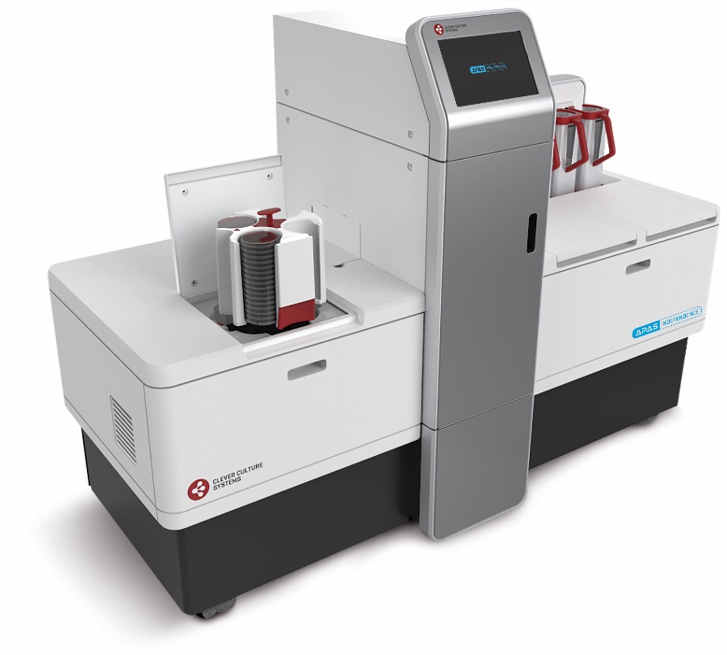
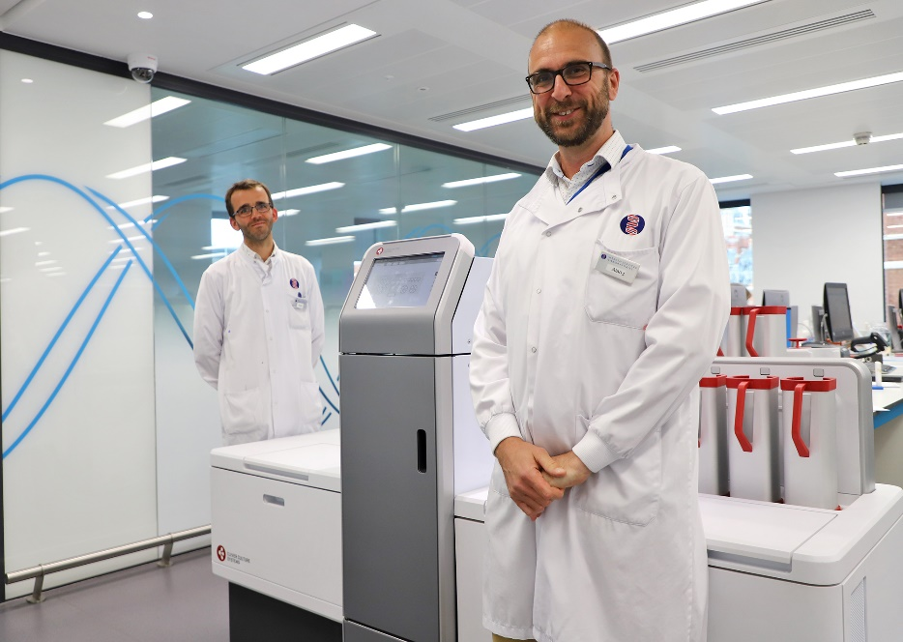
Investment highlights and outlook
No better time to be in microbiology diagnostics
Proven product - Commercial platform to grow
First-in-class technology - Patent protected
Regulatory clearances - FDA, CE Mark, UKCA, TGA
Product launched - Sales in Australia, Germany, UK, US
Channel partners - Thermo Fisher Scientific, Beckman Coulter
Infrastructure to grow - $9.6m Cash (Jun-21)
Commercial outlook - Growing adoption
USA: MRSA analysis module FDA Clearance (Q4-21)
EU and Australia: VRE and Urine analysis modules CE Mark
Growing early adopter sales - Delivered by channel partners
APAS®-AMR - First customer use
Product expansion - New industry verticals created

